Slide 1

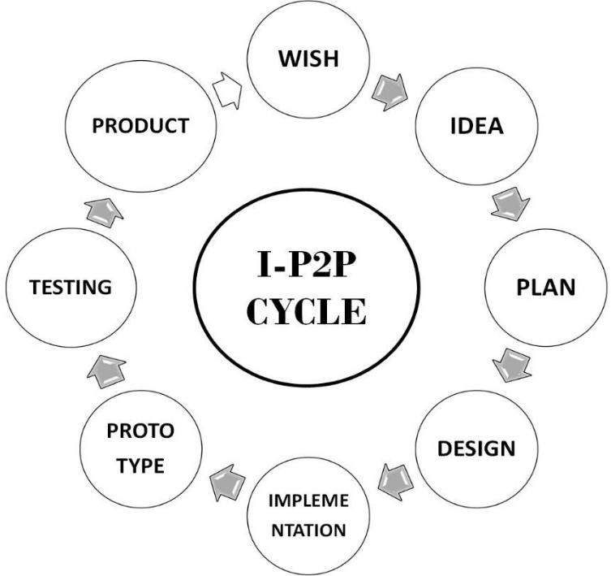
NIC Internship Experience
A journey through web development, machine learning, and automation.
ha

Slide 2

Internships: A Career Booster
1
Real-World Experience
Gain hands-on skills and practical knowledge.
2
Skill Development
Improve technical and professional skills.
3
Networking Opportunities
Connect with industry professionals and build relationships.
4
Personal Growth
Develop valuable skills, including communication and teamwork.

Slide 3

NUTECH Innovation Center
Mission
Convert science into art for industry and society.
Objectives
Foster innovation, research, and talent development.
Innovation in Research
Encourage exploration and novel problem-solving.
Project-to-Product Development
Facilitate the transition of ideas to commercialization.

Slide 4
Web Development Projects
Django Login Page
Local Chatbot
Selenium Automation
Secure authentication and user input handling.
Interactive system trained with Django data.
Automating ticket booking with browser automation.
Gain hands-on experience with Django, HTML/CSS, and JavaScript.
Enhance understanding of Natural Language Processing (NLP).
Gain expertise in browser automation and scripting.

Slide 5

Computer Vision Projects
1
Gesture Recognition
Detect hand movements and control applications.
2
Face Detection
Automatic attendance marking using facial recognition.
3
Feature Extraction
Using VGG16 for image feature extraction and model training.
4
Hybrid CNN + RNN
Combining CNNs and RNNs for advanced face detection.

Slide 6
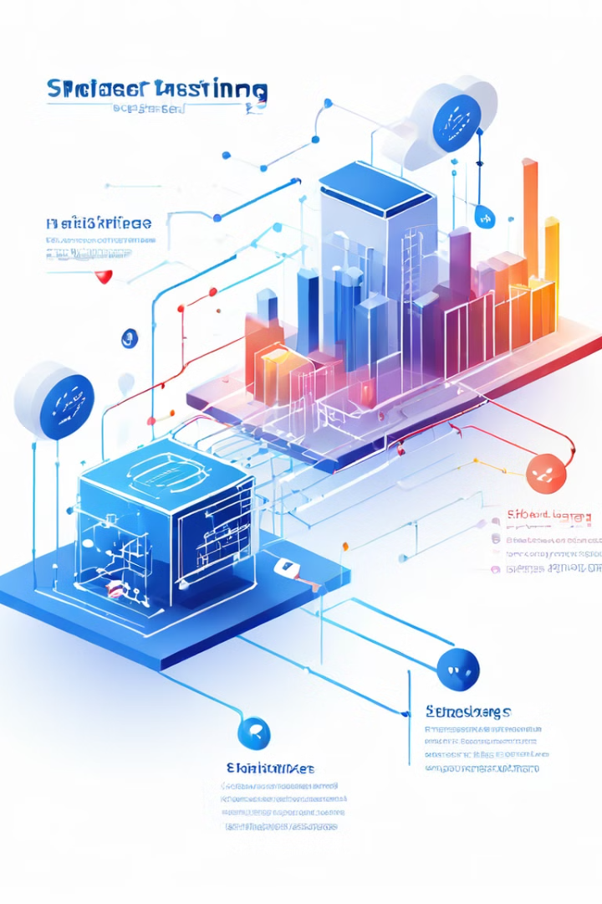



Machine Learning Applications
Predictive Modeling
Data preprocessing, feature selection, model training.
Gesture Control
Control mobile phones using gesture recognition and ML.
Face App
Face detection application with a graphical user interface.

Slide 7





Internship Outcomes
Practical Skills
Applied theoretical knowledge to solve real-world problems.
Innovation
Developed creative solutions to complex challenges.
Networking
Built relationships with professionals and peers.
Personal Growth
Enhanced problem-solving, communication, and teamwork.

Slide 8

Moving Forward
The internship provided a solid foundation for a successful career in technology.

